Slide 1
Chapter 6: Multiple Linear Regression
Data Mining for Business Analytics in R
(c) 2017 Shmueli, Bruce, Yahav & Patel
© Galit Shmueli and Peter Bruce 2017

Slide 2

We assume a linear relationship between predictors and outcome:
outcome
coefficients
constant
error (noise)
predictors
© Galit Shmueli and Peter Bruce 2017

Slide 3
Topics
Explanatory vs. predictive modeling with regression
Example: prices of Toyota Corollas
Fitting a predictive model
Assessing predictive accuracy
Selecting a subset of predictors
© Galit Shmueli and Peter Bruce 2017

Slide 4
Explanatory Modeling
Goal: Explain relationship between predictors (explanatory variables) and target
Familiar use of regression in data analysis
Model Goal: Fit the data well and understand the contribution of explanatory variables to the model
“goodness-of-fit”: R², residual analysis, p-values
© Galit Shmueli and Peter Bruce 2017

Slide 5
Predictive Modeling
Goal: predict target values in other data where we have predictor values, but not target values
Classic data mining context
Model Goal: Optimize predictive accuracy
Train model on training data
Assess performance on validation (hold-out) data
Explaining role of predictors is not primary purpose (but useful)
© Galit Shmueli and Peter Bruce 2017

Slide 6
Example: Prices of Toyota Corolla ToyotaCorolla.xls
Goal: predict prices of used Toyota Corollas based on their specification
Data: Prices of 1442 used Toyota Corollas, with their specification information
© Galit Shmueli and Peter Bruce 2017

Slide 7
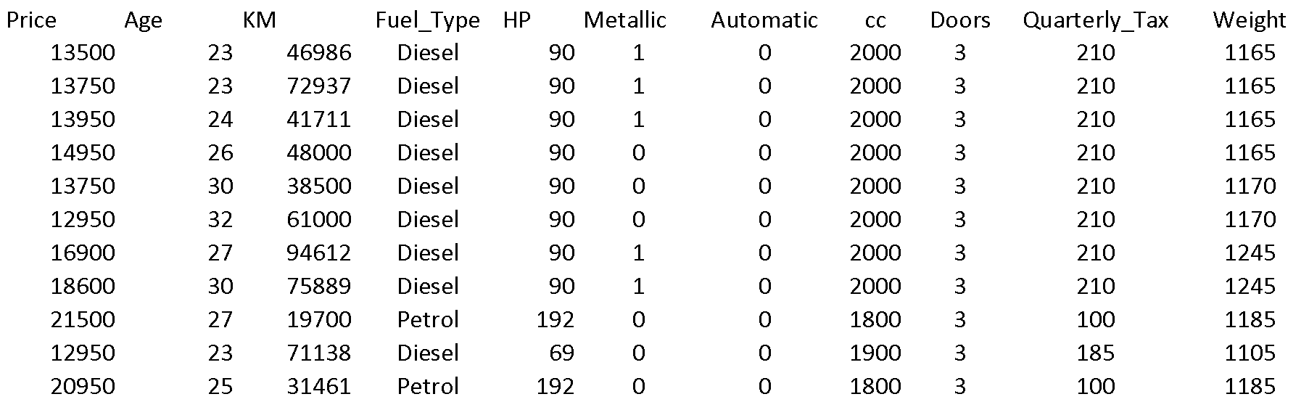
Data Sample (showing only the variables to be used in analysis)
© Galit Shmueli and Peter Bruce 2017

Slide 8
Variables Used
Price in Euros
Age in months as of 8/04
KM (kilometers)
Fuel Type (diesel, petrol, CNG)
HP (horsepower)
Metallic color (1=yes, 0=no)
Automatic transmission (1=yes, 0=no)
CC (cylinder volume)
Doors
Quarterly_Tax (road tax)
Weight (in kg)
© Galit Shmueli and Peter Bruce 2017

Slide 9
Preprocessing
Fuel type is categorical (in R - a factor variable), must be transformed into binary variables. R’s lm function does this automatically.
Diesel (1=yes, 0=no)
Petrol (1=yes, 0=no)
None needed* for “CNG” (if diesel and petrol are both 0, the car must be CNG)
*You cannot include all the binary dummies; in regression this will cause a multicollinearity error. Other data mining methods can use all the dummies.
© Galit Shmueli and Peter Bruce 2017

Slide 10
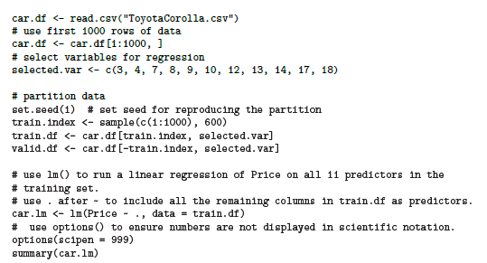
Fitting a Regression Model to the Toyota Data
put 60% in training
correction: 10
© Galit Shmueli and Peter Bruce 2017

Slide 11
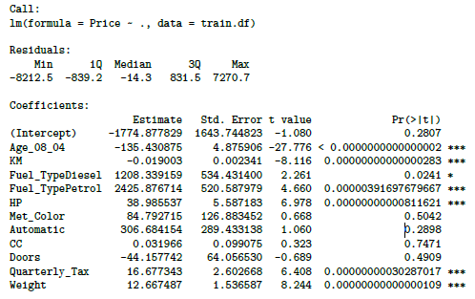
Output of the Regression Model
© Galit Shmueli and Peter Bruce 2017

Slide 12
Accuracy Metrics for the Regression Model
Residual standard error: 1406 on 588
degrees of freedom
Multiple R-squared: 0.8567
Adjusted R-squared: 0.854
F-statistic: 319.6 on 11 and 588 DF
p-value: < 0.00000000000000022
These are traditional metrics, i.e. measured on the training data
© Galit Shmueli and Peter Bruce 2017

Slide 13
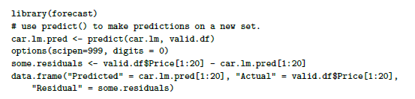
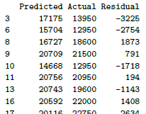
Make the Predictions for the Validation Data
(and show some residuals)
© Galit Shmueli and Peter Bruce 2017

Slide 14
How Well did the Model Do With the Validation Data?
# use accuracy() to compute common accuracy measures.
accuracy(car.lm.pred, valid.df$Price)
ME = mean error
RMSE = root mean squared error
(sq. root of mean squared error)
MAE = mean absolute error
MPE = mean percent error
MAPE = mean absolute percent error
accuracy(car.lm.pred, valid.df$Price)
ME RMSE MAE MPE MAPE
Test set -40.1 1321 1012 -1.72 9.01
“test set” means the data that lm analyzed, not “test set” in the data mining sense
© Galit Shmueli and Peter Bruce 2017

Slide 15
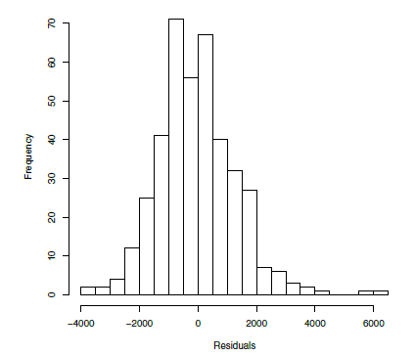
Distribution of Residuals
Symmetric distribution
A few outliers
© Galit Shmueli and Peter Bruce 2017

Slide 16
Selecting Subsets of Predictors
Goal: Find parsimonious model (the simplest model that performs sufficiently well)
More robust
Higher predictive accuracy
We will assess predictive accuracy on validation data
Exhaustive Search = “best subset”
Partial Search Algorithms
Forward
Backward
Stepwise
© Galit Shmueli and Peter Bruce 2017

Slide 17
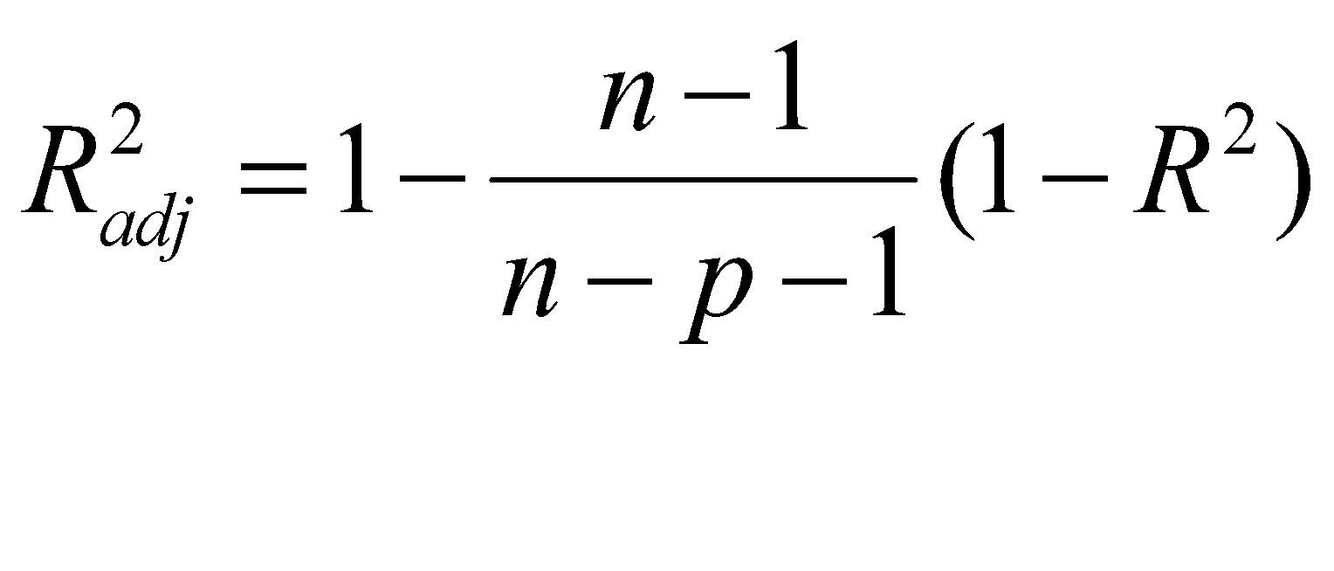
Exhaustive Search = Best Subset
All possible subsets of predictors assessed (single, pairs, triplets, etc.)
Computationally intensive, not feasible for big data
Judge by “adjusted R²”
Use regsubsets() in package leaps
Penalty for number of predictors
© Galit Shmueli and Peter Bruce 2017

Slide 18
Exhaustive search requires library leaps and manual coding into binary dummies
library(leaps)
Fuel_Type <- as.data.frame(model.matrix(~ 0 + Fuel_Type, data=train.df))
train.df <- cbind(train.df[,-4], Fuel_Type[,])
head(train.df)
search <- regsubsets(Price ~ ., data = train.df, nbest = 1, nvmax = dim(train.df)[2], method = “exhaustive”)
sum <- summary(search)
sum$which
sum$rsq
sum$adjr2
sum$Cp
show models
show metrics
© Galit Shmueli and Peter Bruce 2017

Slide 19
Adjusted R² for the models with 1 predictor, 2 predictors, 3 predictors, etc. (exhaustive search method)
> sum$adjr2
[1] 0.7556359 0.7922356 0.8267935 0.8436895 0.8494282 0.8534911
[7] 0.8544782 0.8545430 0.8543943 0.8542602 0.8540382
Adjusted R² rises until you hit 7-8 predictors, then stabilizes, so choose model with 7 predictors, according to the adj R² criterion
© Galit Shmueli and Peter Bruce 2017

Slide 20
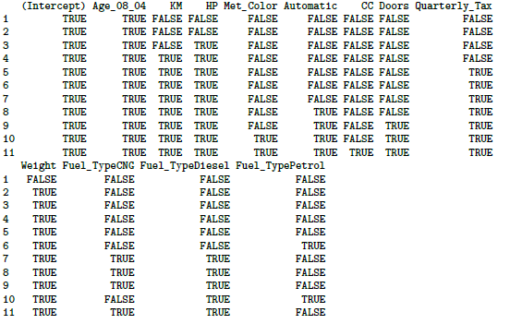
Exhaustive output shows best model for each number of predictors
Note: there are 12 instead of 10 predictors because with leaps we explicitly create dummy variables as part of the dataframe, this is handled internally by lm.
© Galit Shmueli and Peter Bruce 2017

Slide 21
Forward Selection
Start with no predictors
Add them one by one (add the one with largest contribution)
Stop when the addition is not statistically significant
use step() to run stepwise regression (available in lm).
set direction = forward
Specify the initial model (here, model with no predictors), and the bottom of the search range (here with no predictors) and the top (here with all predictors)
© Galit Shmueli and Peter Bruce 2017

Slide 22
# create model with no predictors for bottom of search range
car.lm.null <- lm(Price~1, data = train.df)
# use step() to run forward selection
car.lm.step <- step(car.lm.null,
scope=list(lower=car.lm.null, upper=car.lm), direction =
"forward")
summary(car.lm.step)
# Which variables were added?
initial model
bounds of search range
© Galit Shmueli and Peter Bruce 2017

Slide 23
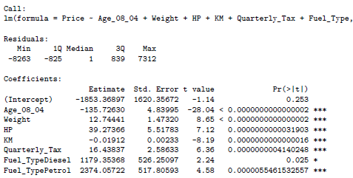
Forward Selection Yields 7 predictor model
© Galit Shmueli and Peter Bruce 2017

Slide 24
Backward Elimination
Start with all predictors
Successively eliminate least useful predictors one by one
Stop when all remaining predictors have statistically significant contribution
car.lm.step <- step(car.lm, direction = "backward")
summary(car.lm.step)
# Which variables were dropped?
(no need to specify search range)
© Galit Shmueli and Peter Bruce 2017

Slide 25
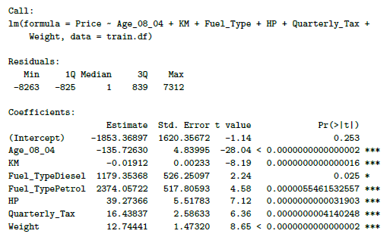
Backward Selection Yields Same 7 Predictors as Forward
© Galit Shmueli and Peter Bruce 2017

Slide 26
Stepwise
Like Forward Selection
Except at each step, also consider dropping non-significant predictors
car.lm.step <- step(car.lm, direction = "both")
summary(car.lm.step)
# Which variables were added/dropped?
© Galit Shmueli and Peter Bruce 2017

Slide 27
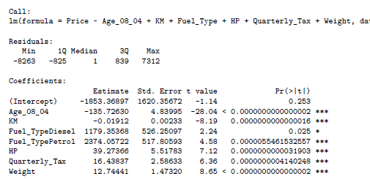
Stepwise Also Yields Same 7 Predictors
© Galit Shmueli and Peter Bruce 2017

Slide 28
Comparing Methods See Tables 6.5 – 6.8
using lm
LEAPS
Variable | Forward | Backward | Both | Exhaustive*
Age_08_04 | ✔ | ✔ | ✔ | ✔
KM | ✔ | ✔ | ✔ | ✔
HP | ✔ | ✔ | ✔ | ✔
Met_Color
Automatic
CC
Doors
Quarterly_Tax | ✔ | ✔ | ✔ | ✔
Weight | ✔ | ✔ | ✔ | ✔
Fuel_TypeCNG |  |  |  | ✔
Fuel_TypeDiesel | ✔ | ✔ | ✔ | ✔
Fuel_TypePetrol | ✔ | ✔ | ✔
*for 7 predictors
Different, but equivalent set of dummies because they were created manually in LEAPS
© Galit Shmueli and Peter Bruce 2017

Slide 29
Reviewing all the methods, these three predictors are consistently the most important:
Variable | Forward | Backward | Both | Exhaustive*
Age_08_04 | ✔ | ✔ | ✔ | ✔
KM | ✔ | ✔ | ✔ | ✔
HP | ✔ | ✔ | ✔ | ✔
Met_Color
Automatic
CC
Doors
Quarterly_Tax | ✔ | ✔ | ✔ | ✔
Weight | ✔ | ✔ | ✔ | ✔
Fuel_TypeCNG |  |  |  | ✔
Fuel_TypeDiesel | ✔ | ✔ | ✔ | ✔
Fuel_TypePetrol | ✔ | ✔ | ✔
*for 7 predictors
© Galit Shmueli and Peter Bruce 2017

Slide 30
Summary
Linear regression models are very popular tools, not only for explanatory modeling, but also for prediction
A good predictive model has high predictive accuracy (to a useful practical level)
Predictive models are fit to training data, and predictive accuracy is evaluated on a separate validation data set
Removing redundant predictors is key to achieving predictive accuracy and robustness
Subset selection methods help find “good” candidate models. These should then be run and assessed.
© Galit Shmueli and Peter Bruce 2017

